Slide 1
PHD Progression 9
Explainable AI with Visual analytics

Slide 2

Attention mechanism
Attention helps to capture long range relationship of tokens
Simplified self attention introduces the broad idea of attention
Self attention: with trainable weight , forms the basis of the mechanism used in LLMs
Causal self attention: A type of attention used in LLMs that allows only the consideration of previous and current input
Multi-head attention: An extension of self attention and causal attention that enables the model to simultaneously attend to information from different subspaces

Slide 3
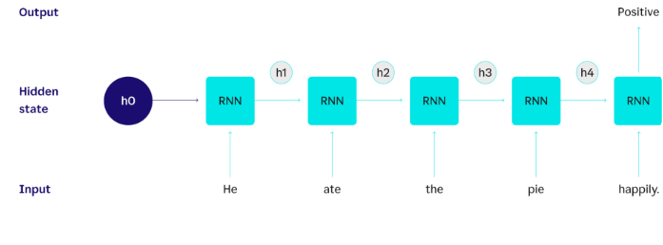
History of transformers and attention
Before transformers, RNNs was used for encoder-decoder architecture
Decoder only has access to the last hidden state, in long sentences situation

Slide 4
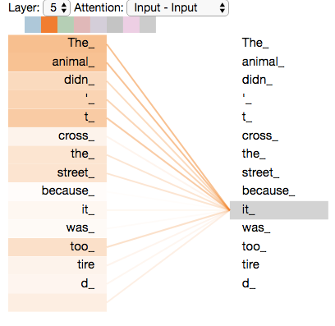
Attention and Self-attention
1980 RNNs 1997 LSTMS
2014 Attention 2017 Transformers
Self attention: is a mechanism that allows each position of the input sequence to attend to all positions in the same sequence when computing the representation of a sequence

Slide 5
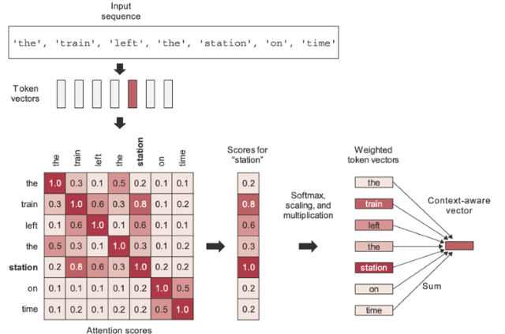
Simplified attention mechanism
For simplified attention mechanism attention score is calculated by getting the dot product of a token(query) in the sequence and every other token in the sequence
Normalization of attention score using soft max gives the attention weight
The dot product of the attention score and vector embedding produces context weight

Slide 6
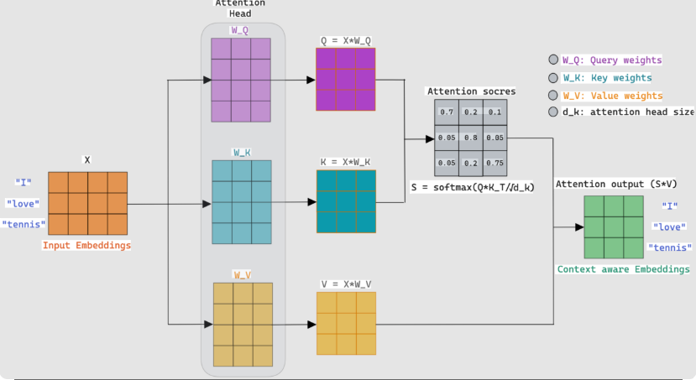
Attention for self mechanism
For self attention mechanism, attention scores are calculated using weighted vectors Wq, Wk, and Wv as vectors for dot multiplication with input embedding
These produce the Query, Key and value vectors
Dot product of the Query and Key produces the attention score

Slide 7
Attention for self mechanism
Scaling by dividing the attention score by the square root of the key dimension
Then normalizing the divided attention score with the SoftMax function to obtain attention weight
Context vector = attention weight * Value

Slide 8

Trainable weight vs no trainable weights
With trainable weights we can identify more relationships between tokens even if words are not semantically related. Long range dependency in the sequence is better captured. Through training and back propagation these weights are adjusted to better understand the relationship between tokens

Slide 9
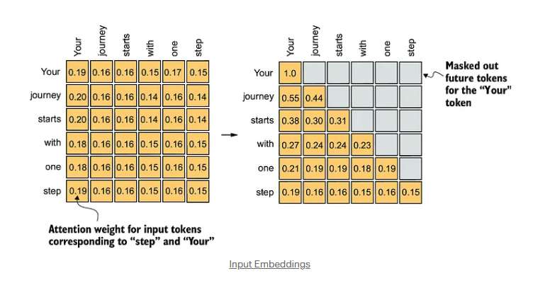
Causal Attention
Also known as masked attention
It restricts the model to only consider previous and current inputs in a sequence
We use triu and set the values to –Infinity and use this for masking attention score to prevent data leakage
Scaling by dividing the attention score by the square root of the key dimension
Then normalizing the divided attention score with the SoftMax function to obtain attention weight

Slide 10
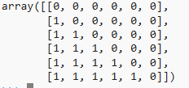
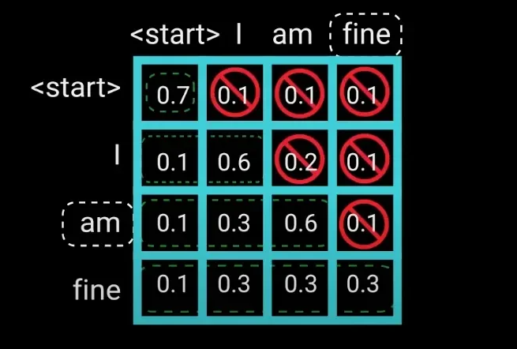
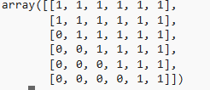
Triu (-inf), Tril(0) and The data leakage

Slide 11
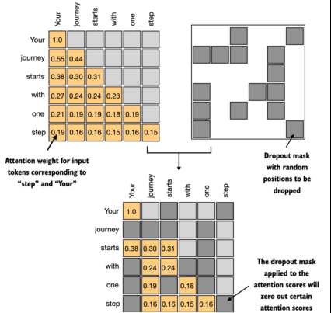
Dropout function
Prevents overfitting and good for generalization
Optimizes the system by activating inactive neurons
Randomly zeros out values
Can be applied after calculating attention scores or attention weight

Slide 12
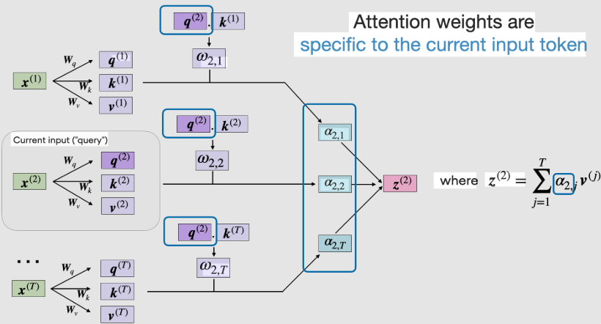
MultiHead attention
Multihead mechanism refers to dividing the attention mechanism into multiple heads, each operating independently.
Stacking multiple attention head layers
Computationally expensive but good for complex pattern recognition

Slide 13
Supervisors’ Feedback
Use more everyday examples
Implement visualization code into the LLM with D3.js
Look into conferences and start considering presenting at one

